Slide 1
IOT BASED PATIENT HEALTH MONITORING SYSTEM USING ESP32
231040060 - M. Sowmya
2310040112 – K. Sushma
2310049143 – B .Srija
2310049144 – B . Tharuni

Slide 2
IOT BASED PATIENT HEALTH MONITORING SYSTEM USING ESP32
Problem statement : The healthcare industry is continually evolving with the increasing demand for innovative solutions to improve patient care, particularly in remote and underserved areas. A key challenge faced by healthcare professionals is the ability to monitor patients' health status continuously, especially for patients with chronic conditions or those requiring constant supervision. Traditional healthcare methods are often limited by the availability of medical staff, time constraints, and geographical barriers.
The goal of this project is to design and implement an IoT-based Patient Health Monitoring System using ESP32 to remotely monitor vital health parameters such as heart rate, body temperature, blood pressure, and oxygen saturation (SpO2) in real-time. This system will enable healthcare professionals or family members to monitor the health of patients remotely, ensuring timely intervention when needed.

Slide 3
INTRODUCTION
An IoT-based patient health monitoring system leverages connected devices that continuously gather real-time data on health parameters such as heart rate, blood pressure, body temperature, and oxygen saturation (SpO2). This data is then transmitted wirelessly over the internet to a cloud server, mobile application, or a healthcare dashboard, where medical professionals or family members can access it remotely. The integration of such a system not only allows for continuous health surveillance but also enables timely medical intervention in case of emergencies or abnormal readings.
This project aims to develop an efficient, cost-effective, and reliable solution for continuous health monitoring, which will ultimately improve patient care, enhance the effectiveness of treatments, and reduce healthcare costs by allowing early detection of health issues. The system also has the potential to support elderly and remote patients, who are often at risk due to the lack of immediate access to medical care.

Slide 4
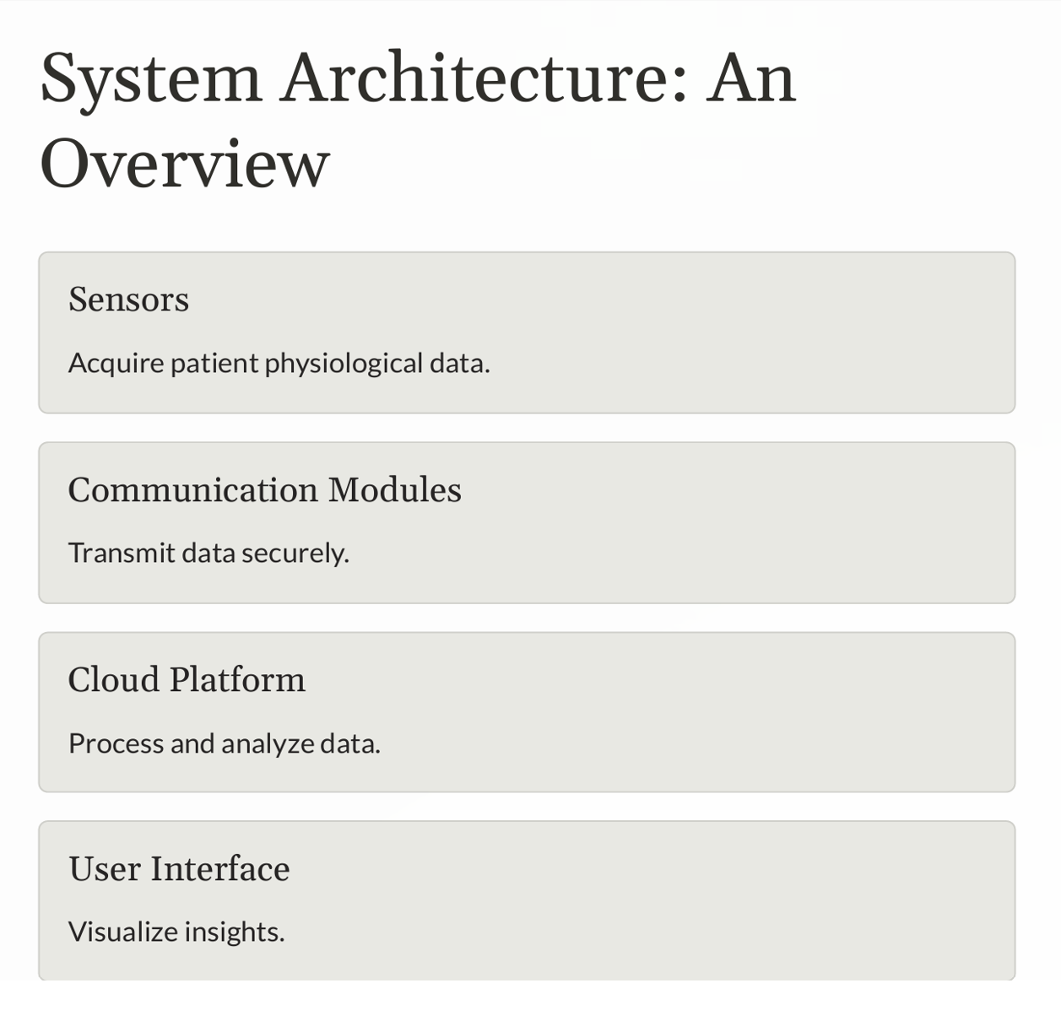
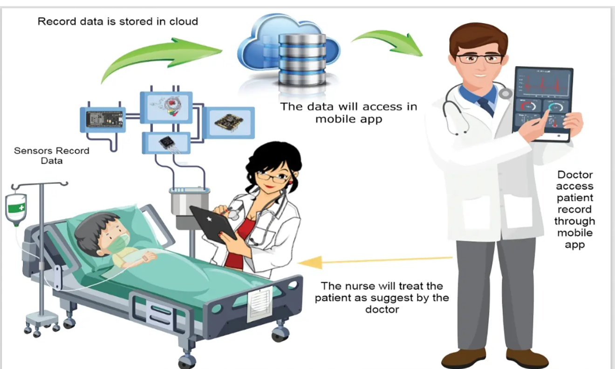

Slide 5
S.No | Components Name | Quantity | Amount(in rupees)
01 | ESP 32 | 01 | 350
02 | MAX30100 Pulse Oximeter Sensor | 01 | 270
03 | DS18B20 Sensor | 01 | 100
04 | DHT11 Sensor | 01 | 200
05 | Resistor 4.7K | 01 | 2
06 | Connecting Wires | 10 | 50
07 | Bread Board | 01 | 160

Slide 6
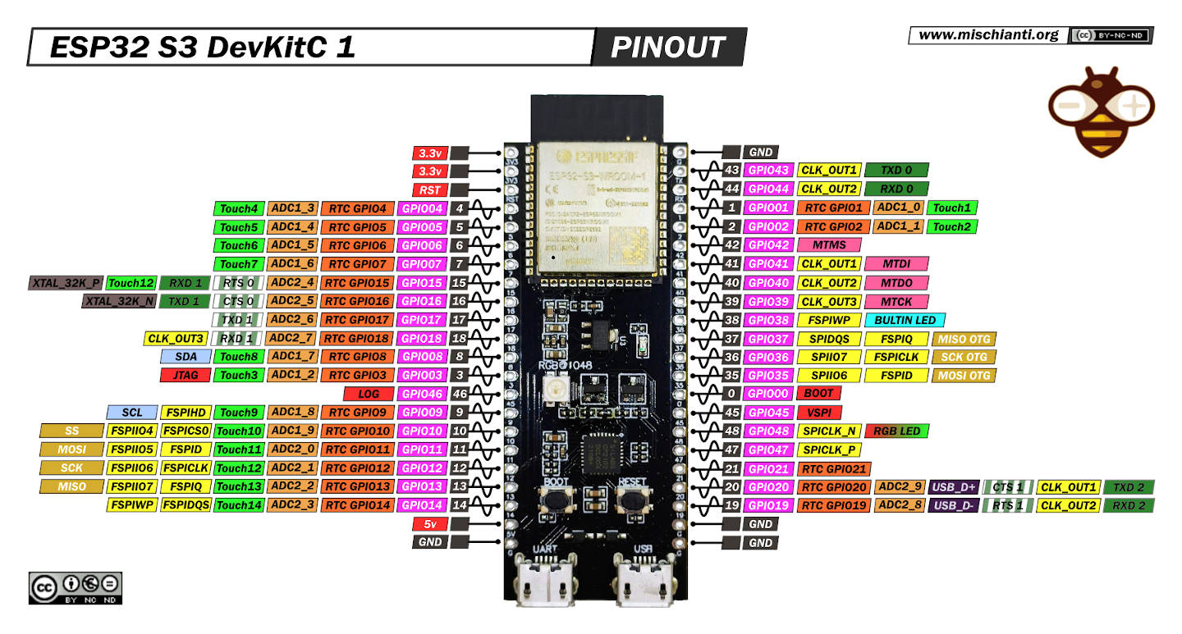
COMPONENTS DESCRIPTION
1. ESP 32:
The ESP32 is a powerful, low-cost, and low-power system-on-chip (SoC) microcontroller developed by Espressif Systems. It is widely used in IoT-based projects due to its integrated Wi-Fi, Bluetooth, and dual-core processor, which make it ideal for applications that require wireless communication, real-time data processing, and sensor integration—all in a compact and energy-efficient package.

Slide 7
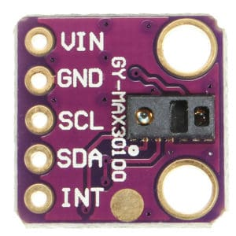
2.Max30100 Pulse Oximeter Sensor
The sensor is integrated pulse oximetry and heart-rate monitor sensor solution. It combines two LED’s, a photodetector, optimized optics, and low-noise analog signal processing to detect pulse and heart-rate signals. It operates from 1.8V and 3.3V power supplies and can be powered down through software with negligible standby current, permitting the power supply to remain connected at all times.

Slide 8
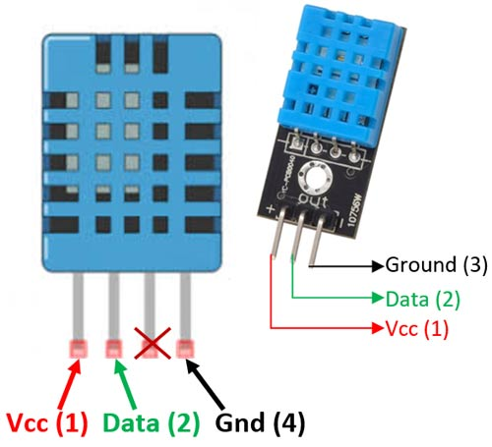
3. DHT11 Temperature and Humidity Sensor:
The DHT11 is a basic, ultra-low-cost digital sensor used to measure temperature and humidity. It is commonly used in IoT projects for environmental monitoring. In a patient health monitoring system, monitoring ambient temperature and humidity is important for maintaining a comfortable and safe environment—especially for patients with respiratory or cardiovascular conditions.

Slide 9
4. DS18B20 Temperature Sensor
This is a pre-wired and waterproofed version of the DS18B20 sensor. Handy for when you need to measure something far away, or in wet conditions. The Sensor can measure the temperature between -55 to 125°C (-67°F to +257°F). The cable is jacketed in PVC.
Because it is digital, there is no signal degradation even over long distances. These 1-wire digital temperature sensors are fairly precise, i.e ±0.5°C over much of the range. It can give up to 12 bits of precision from the onboard digital-to-analog converter. They work great with any microcontroller using a single digital pin.

Slide 10
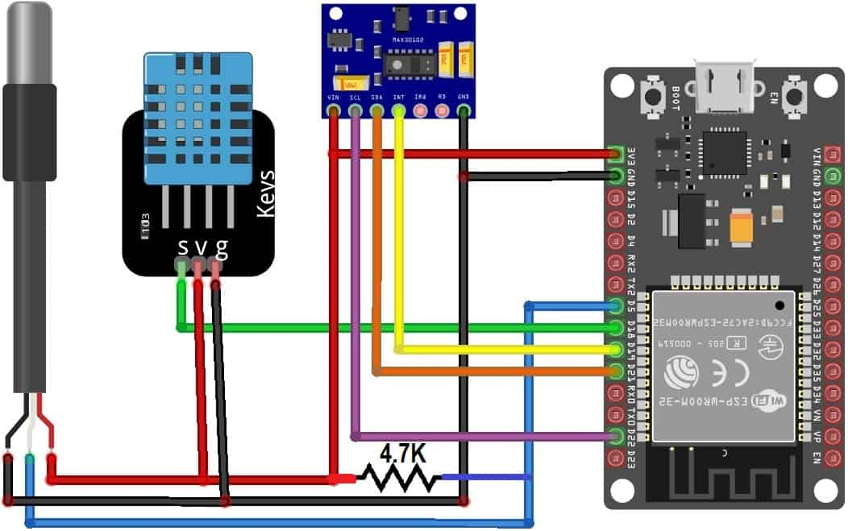
BLOCK DIAGRAM

Slide 11
All the sensor can work at 3.3V VCC. So connect their VCC to 3.3V Power Supply. Connect the GND to GND. MAX30100 is an I2C Sensor, so connect its SDA & SCL pin to GPIO21 & GPIO22. Connect its INT pin to GPIO19 of ESP32. The output pin of DHT11 is connected to GPIO18 of ESP32. Similarly, the output pin of DS18B20 is connected to GPIO5 of ESP32. A 4.7K pull-up resistor is connected between output pin & VCC pin of DS18B20.

Slide 12
Libraries that are installed
1.Arduino MAX 30100 Library
2.One Wire Library
3.Dallas Temperature Library
4.DHT 11 library

Slide 13
ADVANTAGES
Enables real-time monitoring of patient vitals.
Provides remote access to health data anytime, anywhere.
Uses built-in Wi-Fi/Bluetooth for seamless wireless connectivity.
Offers low-cost and compact design ideal for wearables.
Sends instant alerts in case of health emergencies.
Supports integration with cloud platforms for data storage.
Allows easy addition of extra sensors for scalability.
Ensures energy efficiency with ESP32's low-power modes.
Facilitates historical data logging and trend analysis.
Increases patient awareness and engagement in their health.

Slide 14
APPLICATIONS
Remote Patient Monitoring
Elderly Care at Home
Post-Surgical Recovery Monitoring
ICU and Hospital Use
Rural and Remote Area Healthcare
Mobile Clinics and Ambulances
Wearable Health Devices
Pandemic or Quarantine Monitoring

Slide 15
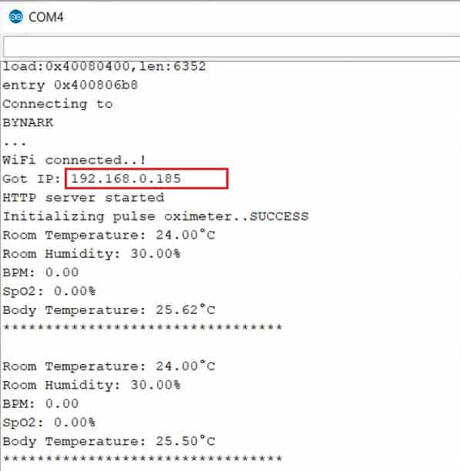
RESULT
Once the code is uploaded, you can open the serial monitor. The ESP32 will try to connect to a network. Once connected, it will display the IP Address.

Slide 16
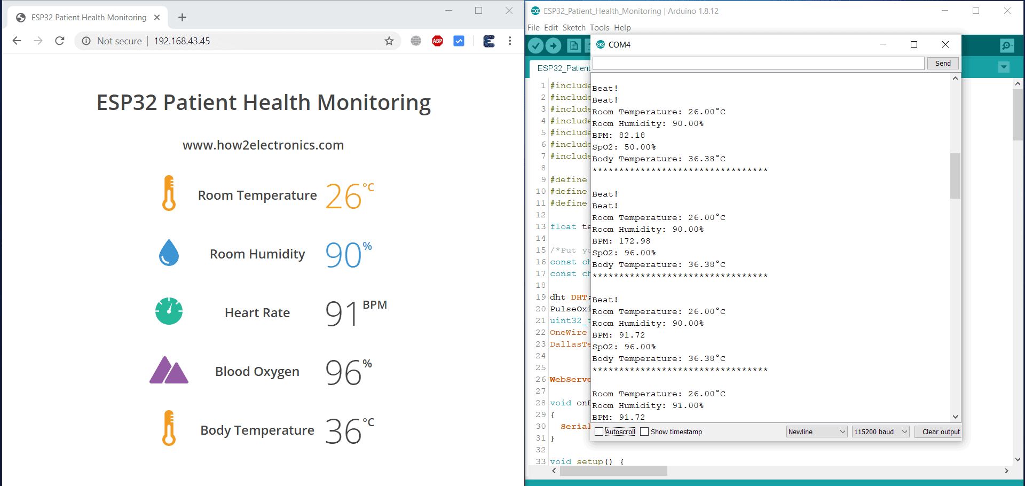
Copy the IP Address and paste it on any of the Web Browser and hit enter. You will see the room temperature, room humidity, Heart Rate, Blood Oxygen Level, Body Temperature, etc.

Slide 17
CONCLUSION
The development of an IoT-based Patient Health Monitoring System using ESP32 presents a significant advancement in the field of remote healthcare. By leveraging the capabilities of the ESP32 microcontroller, this system offers a cost-effective, scalable, and efficient solution for continuous health monitoring, particularly in resource-limited settings.
Through the integration of biomedical sensors such as temperature, heart rate, and SpO₂ monitors, real-time health data is collected and transmitted wirelessly to cloud platforms for visualization and analysis. The use of platforms like ThingSpeak, Firebase, or Blynk enhances accessibility by enabling doctors, caregivers, and patients to monitor vital signs from anywhere at any time.
The system’s ability to send alerts in case of abnormal readings ensures that timely medical intervention can be provided, reducing the risk of serious complications. This feature is particularly valuable for elderly individuals, patients with chronic conditions, and individuals living in remote areas.

